Slide 1
Heuristic Search(1)
하 진 영
강원대학교 컴퓨터공학과

Slide 2
Turing Award Lecture, Newell and Simon, 1976
The task that a symbol system is faced with, then, when it is presented with a problem and a problem space, is to use its limited processing resources to generate possible solutions, one after another, until it finds one that satisfies the problem defining test. If the symbol system had some control over the order in which potential solutions were generated, then it would be desirable to arrange this order of generation so that actual solutions would have a high likelihood of appearing early. A symbol system would exhibit intelligence to the extent that is succeeded in doing this. Intelligence for a system with limited processing resources consists in making wise choices of what to do next...

Slide 3
Introduction
Definition of heuristic
the study of the methods and rules of discovery and invention, Polya 1945
Greek root eurisco: “I discover”
Archimedes shouted “Eureka!” meaning “I have found it!”
In state space search
heuristics are formalized as rules for choosing those branches in a state space that are most likely to lead to an acceptable problem solution

Slide 4
Introduction (2)
AI problem solvers employ heuristics in two basic situations
A problem may not have an exact solution because of inherent ambiguities in the problem statement or available data.
e.g. medical diagnosis, vision
A problem may have an exact solution, but the computational cost of finding it may be prohibitive.
e.g. chess

Slide 5
Introduction (3)
Heuristics
fallible like all rules of discovery and invention
only an informed guess of the next step to be taken in solving a problem
seldom able to predict the exact behavior of the state space farther along in the search
because heuristics use limited information

Slide 6
Heuristics and The Algorithm
Heuristics and the design of algorithm to implement heuristic search
a core concern of artificial intelligence research
game playing and theorem proving → two of the oldest applications
Expert systems research
affirmed the importance of heuristics as an essential component of problem solving
“rules of thumb”
human expert uses to solve problems
largely heuristic in nature

Slide 7
Heuristic Algorithm
Two parts
the heuristic measure
an algorithm that uses it to search the state space
best-first search

Slide 8
Tic-Tac-Toe
Combinatorics for exhaustive search
9!
Symmetry reduction
12×7!
A simple heuristic
can almost eliminate search entirely
may move to the board in which X has the most winning lines
a crude upper bound: 8 ×9 or 72 states

Slide 9
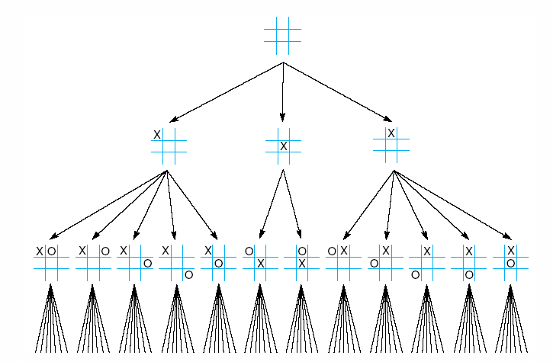
Fig 4.1 First three levels of the tic-tac-toe state space reduced by symmetry

Slide 10
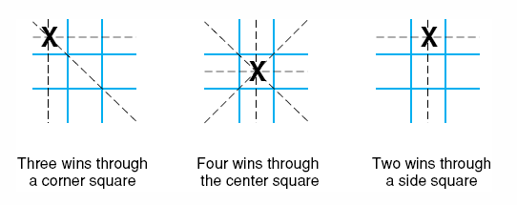
The “Most Wins” Heuristic
Fig 4.2 The “most wins” heuristic applied to the first children in tic-tac-toe.

Slide 11
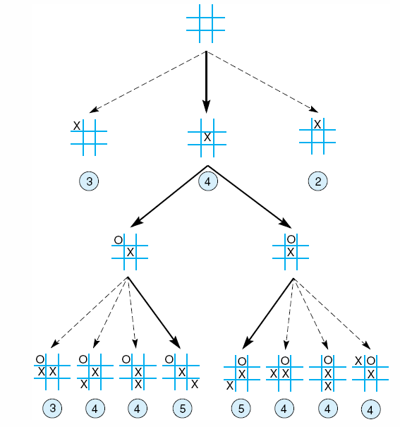
Fig 4.3 Heuristically reduced state space for tic-tac-toe.

Slide 12
Implementing Best-First Search
Hill climbing, Pearl 1984
the simplest way to implement heuristic search
hill climbing strategies expand the current node in the search and evaluate its children
best child is selected for further expansion; neither its siblings nor its parent are retained
search halts when it reaches a state that is better than any of its children

Slide 13
Hill-Climbing Strategies
Problems
an erroneous heuristic can lead along infinite paths that fail
because it keeps no history, the algorithm cannot recover from these failures
can also become stuck at local maxima (Fig. 4.4)
Performance improvement in hill-climbing
perturbation
no way of guaranteeing optimal performance
effectively used if
the evaluation function is sufficiently informative to avoid local maxima and infinite paths

Slide 14
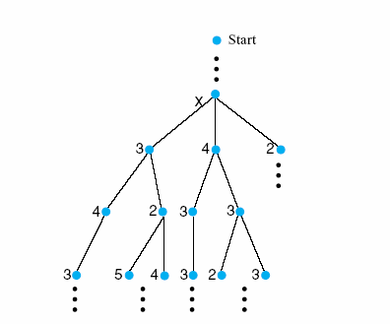
Fig 4.4 The local maximum problem for hill-climbing with 3-level look ahead
Notes:
Insert fig 4.4

Slide 15
Dynamic Programming
Dynamic programming (DP)
other names
forward-backward
Viterbi algorithm
restricted memory search in problems composed of multiple interacting and interrelated subproblems
keeps track of and reuses subproblems already searched and solved within the solution of the larger problem
Example
solution of Fibonacci series
optimum global alignment of two strings
minimum edit difference between two strings

Slide 16

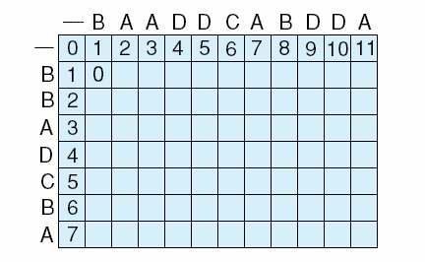
Fig 4.5 The initialization stage and first step in completing the array for character alignment using dynamic programming.
Notes:
Insert fig 4.5 WITH BAADDCABDDA
BBADC B A

Slide 17
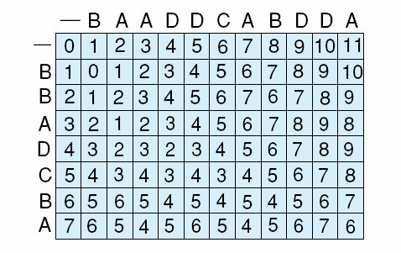
Fig 4.6 The completed array reflecting the maximum alignment information for the strings.
Row-column element
global alignment success to that point
three possible costs
shift : 1 (row score)
insert : 1 (column score)
shift and insert : 2
identical : 0 (diagonal score)

Slide 18
Dynamic Programming
Forward stage
fill array from upper left corner by considering partial matching successes to current point
value of intersection of row x and column y, (x, y), is a function of one of three values in
(x-1, y)
(x-1, y-1)
(x, y-1)
Backward stage
from the best alignment count, we produce a specific alignment of the characters
begin at maximum row by column value, we move back through the array, at each step selecting one of the immediate state’s predecessors

Slide 19
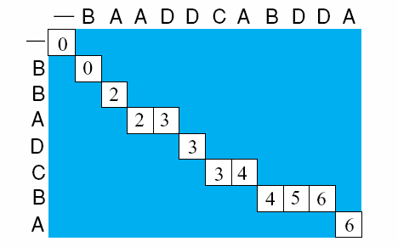
Fig 4.7 A completed backward component of the dynamic programming example giving one (of several possible) string alignments.
1
1
2

Slide 20
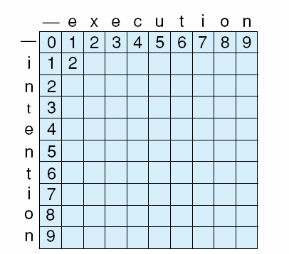
Fig 4.8 Initialization of minimum edit difference matrix between intention and execution (adapted from Jurafsky and Martin, 2000).
possible costs
1 for character insertion or deletion
2 for replacement (a deletion plus an insertion)
Notes:
Insert fig 4.8

Slide 21
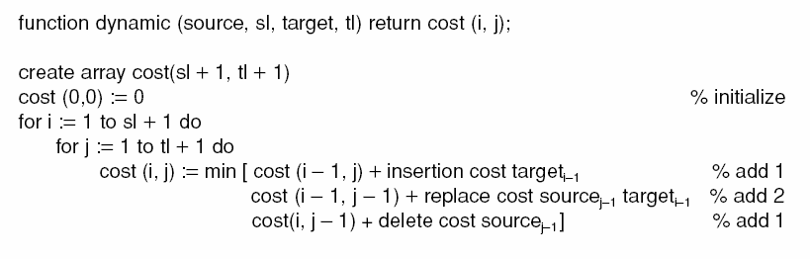

Slide 22
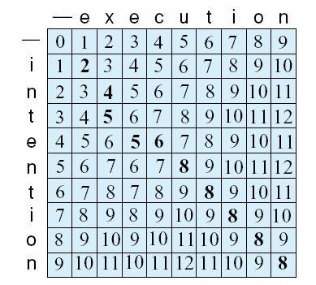
Fig 4.9 Complete array of minimum edit difference between intention and execution (adapted from Jurafsky and Martin, 2000) (of several possible) string alignments.
intention
ntention delete i, cost 1
etention replace n with e, cost 2
exention replace t with x, cost 2
execntion insert c, cost 1
execution replace n with c, cost 2

Slide 23
Best-First Search
A more informed heuristic search algorithm
open list
to keep track of the current fringe of the search
closed list
to record states already visited
added up step
orders the states on open according to some heuristic estimate of their “closeness” to a goal

Slide 24
Procedure best_first_search;
begin
open := [start]; % initialize
closed := [];
while open ≠ [] do % states remain
begin
remove the leftmost state from open, call it X;
if X = goal then return the path from Start to X
else begin
generate children of X;
for each child of X do
case
the child is not open or closed:
begin
assign the child a heuristic value;
add the child to open
end;
the child is already on open:
if the child was reached by a shorter path
then give the state on open the shorter path
the child is already on closed:
if the child was reached by a shorter path then
begin
remove the state from closed;
add the child to open
end;
end; % case
put X on closed;
re-order states on open by heuristic merit(best leftmost)
end;
return failure % open is empty
end.

Slide 25
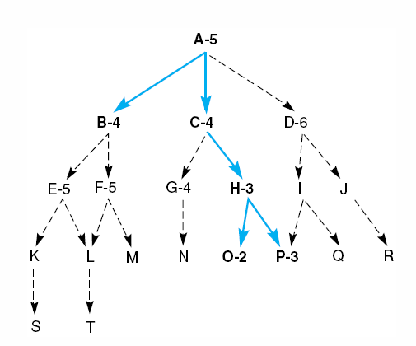
Heuristic Search of a Hypothetical State Space
Fig 4.10 Heuristic search of a hypothetical state space.

Slide 26
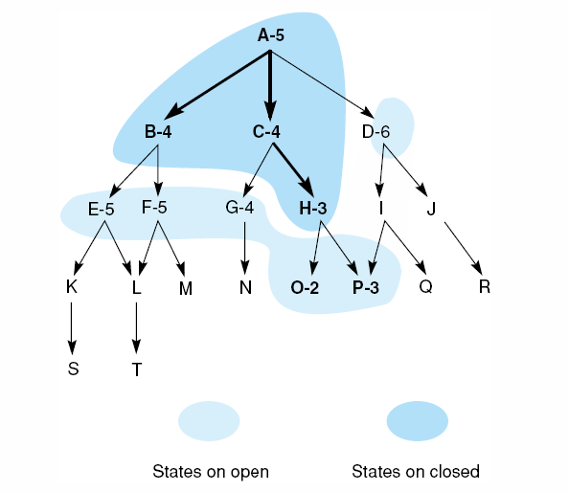
Fig 4.11 Heuristic search of a hypothetical state space with open and closed states highlighted.

Slide 27
Best-First Search (2)
A trace of the execution of best_first_search
1. open = [A5]; closed = []
2. evaluate A5; open = [B4,C4,D6]; closed = [A5]
3. evaluate B4; open = [C4,E5,F5,D6]; closed = [B4,A5]
4. evaluate C4; open = [H3,G4,E5,F5,D6]; closed = [C4,B4,A5]
5. evaluate H3; open = [O2,P3,G4,E5,F5,D6]; closed = [H3,C4,B4,A5]
6. evaluate O2; open = [P3,G4,E5,F5,D6]; closed = [O2,H3,C4,B4,A5]
7. evaluate P3; the solution found!
Unlike hill climbing, the algorithm recovers the error and finds the correct goal
the heuristic is fallible: the state O has a lower value than the goal itself and is examined first

Slide 28
Best-First Search (3)
The best-first search
always selects the most promising state on open for further expansion.
however, as it is using a heuristic that may prove erroneous, it does not abandon all the other states but maintains them on open
in the event a heuristic leads the search down a path that proves incorrect, the algorithm may retrieve some previously generated “next best” state from open and shift its focus to another part of the space

Slide 29
Implementing Heuristic Evaluation Function
Evaluation of the performance of several different heuristics for solving the 8-puzzle
The simplest heuristic
to count the tiles out of place in each state when it is compared with the goal
intuitively appealing, but does not use all of the information available in a board configuration
the distance the tiles must be moved
A “better” heuristic
to sum all the distances by which the tiles are out of place, one for each square a tile must be moved to reach its position in the goal state

Slide 30
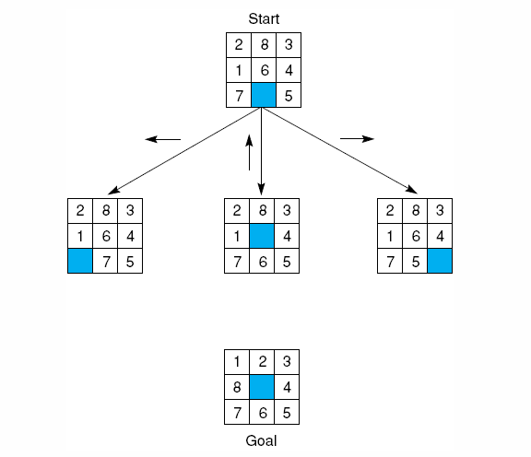
Fig 4.12 The start state, first moves, and goal state for an example-8 puzzle.

Slide 31
Criticism for the Heuristics
Failing to acknowledge the difficulty of tile reversals
if two tiles are next to each other and the goal requires their being in opposite locations, it takes more than two moves
Fig. 4.13
Another heuristic
multiplies a small number(e.g. 2) times each direct tile reversal

Slide 32
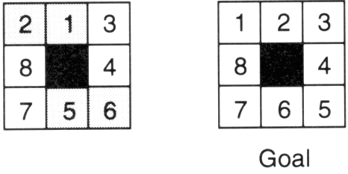
Tile Reversal Example
Fig 4.13 An 8-puzzle state with a goal and two reversals:
1 and 2, 5 and 6.

Slide 33
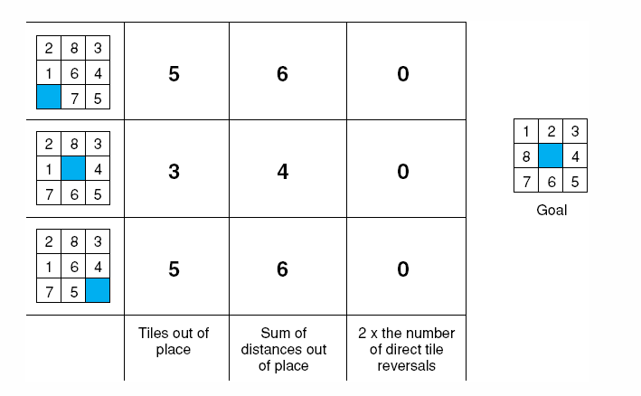
Fig 4.14 Three heuristics applied to states in the 8-puzzle.

Slide 34
A Fourth Heuristic
Limitations of the tile reversal heuristic
fails to distinguish when none of states have any direct reversals (see Fig. 4.14)
To overcome the above
adds the sum of the distances out of place and 2 times the number of direct reversals

Slide 35
Design of Good Heuristics
Above examples
shows difficulty of devising good heuristics
Our goal
to use the limited information available in a single state descriptor to make intelligent choices
Design of good heuristic → Empirical problem
judgement and intuition help
but the final measure must be its actual performance on problem instances

Slide 36
Depth Count
Motivation
use depth count to detect fruitless paths in depth-first search
Objective
to prefer the shortest path from the starting state
Depth count
0 for the beginning state
incremented 1 for each level of the search
f(n) = g(n) + h(n)
g(n) measures the actual length of the path from any state n to the start state
h(n) is a heuristic estimate of the distance from state n to a goal

Slide 37
8-Puzzle Example
f(n) = g(n) + h(n)
g(n): actual distance from n to the start state
h(n): number of tiles out of place
In Figure 4.15
values of f(n) for each state
6 = 1 + 5
4 = 1 +3
6 = 1 + 5

Slide 38
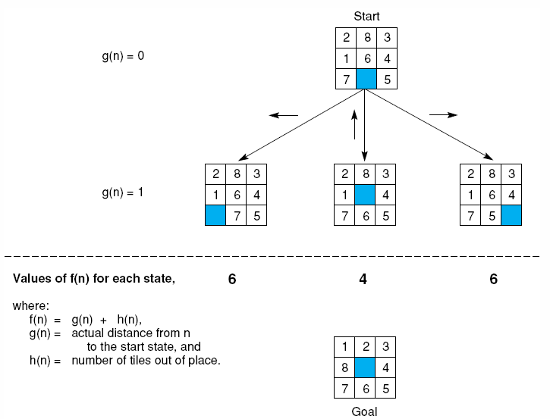
Fig 4.15 The heuristic f applied to states in the 8-puzzle.

Slide 39
8-Puzzle Example (2)
Full best-search of the 8-puzzle graph
using f as defined
each state is labeled with a letter and its heuristic weight, f(n)= g(n) + h(n)
the number at the top of each state → the order in which it was taken off the open list
some states (h,g,b,d,n,k, and i) are not so numbered, because they were still on open when the algorithm terminated

Slide 40
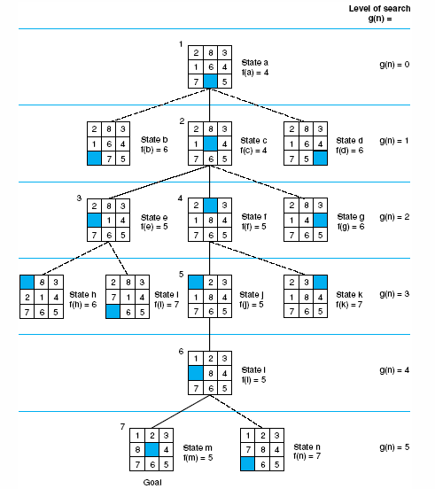
Fig 4.16 State space generated in heuristic search of the 8-puzzle graph.

Slide 41
8-Puzzle Example (3)
Successive stages of open and closed
1. open = [a4]; closed = []
2. open = [c4,b6,d6]; closed = [a4]
3. open = [e5,f5,g6,b6,d6]; closed = [a4,c4]
4. open = [f5,h6,g6,b6,d6,i7]; closed = [a4,c4,e5]
5. open = [j5,h6,g6,b6,d6,k7,i7]; closed = [a4,c4,e5,f5]
6. open = [l5,h6,g6,b6,d6,k7,i7]; closed = [a4,c4,e5,f5,j5]
7. open = [m5,h6,g6,b6,d6,n7,k7,i7]; closed = [a4,c4,e5,f5,j5,l5]
8. success, m = goal !

Slide 42
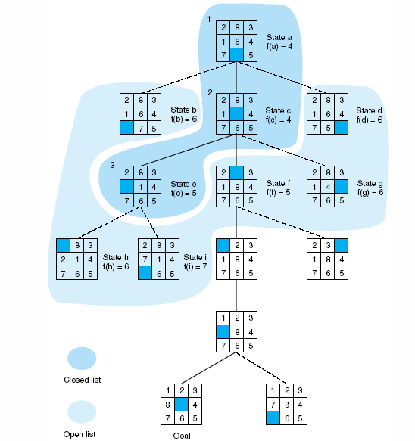
Fig 4.17 Open and closed as they appear after the 3rd iteration of heuristic search

Slide 43
Evaluation Function and best_first_search
f(n) = g(n) + h(n)
h value guides search toward heuristically promising states
g value prevents search from persisting indefinitely on a fruitless path
open list
states on open are sorted by their f values
by keeping all states on open until they are examined or a goal is found, the algorithm can go back from fruitless paths
open may contain states at different levels → flexibility in changing focus of the search

Slide 44
Heuristic Search and Expert Systems
Implementing heuristics
use of confidence measures by expert systems to weigh the results of a rule
expert systems employ confidence measure to select the conclusions with the highest likelihood of success
states with extremely low confidences can be eliminated entirely

Slide 45
Heuristic Search and Expert Systems (2)
Reasons for using simple games (8-puzzle)
1. The search spaces are large enough to require heuristic pruning.
2. Most games are complex enough to suggest a rich variety of heuristic evaluations for comparison and analysis.
3. Games are generally do not involve complex representational issues.
4. A single heuristic may be applied throughout the search space.

Slide 46
Heuristic Search and Expert Systems (3)
More realistic problems
greatly complicate the implementation and analysis of heuristic search
insights gained from simple games generalize to problem such as those found in expert systems application
a single heuristic may not apply to each state
each rule is a heuristic that may be applied in a particular case
pattern matcher matches the appropriate rule (heuristic) with the relevant state in the space

Slide 47
Example: The Financial Advisor
So far, knowledge base
has been treated as a set of logical implications
conclusions are either true or false
In actuality
these rules are highly heuristic in nature
e.g. one rule states that an individual with adequate savings and income should invest in stocks:
savings_account(adequate)∧income(adequate) ⇒ investment(stocks).

Slide 48
Example: The Financial Advisor (2)
In reality,
it is possible that such an individual may prefer the added security of a combination strategy or even that of placing all investment money in savings
Thus, the rule is a heuristic
The problem solver should try to account for this uncertainty
We could take additional factors, such as the age of the investor and the long-term prospects for security and advancement in the investor’s profession, into account to make the rules more informed and capable of finer distinctions. However, this does not change the fundamentally heuristic nature of financial advice.

Slide 49
Example: The Financial Advisor (3)
Confidence measure or certainty factor
one way in which expert systems use
attach a real number between -1 and 1 to the conclusion of each rule
e.g.
savings_account(adequate)∧income(adequate) ⇒ investment(stocks) with confidence = 0.8.
savings_account(adequate)∧income(adequate) ⇒ investment(combination) with confidence = 0.5.
savings_account(adequate)∧income(adequate) ⇒ investment(savings) with confidence = 0.1.

Slide 50
Example: The Financial Advisor (4)
Heuristic search algorithm can use certainty factors in a number of ways:
the results of all applicable rules could be produced along with their associated confidences→ exhaustive search
the program might return only the result with the strongest confidence value → radical pruning
a more conservative pruning strategy could ignore rules that draw a conclusion with a confidence less than a certain value (0.2 for example)

Slide 51
Heuristic Search(2)
하 진 영
강원대학교 컴퓨터공학과

Slide 52
Admissibility, Monotonicity, and Informedness
Evaluation of the behavior along a number of dimensions:
may require to find the shortest path
could be important when an application might have an excessive cost for extra solution steps
Heuristics that find the shortest path to a goal whenever it exists → admissibility
may want to ask whether any better heuristics are available → informedness
guarantee that the same state won’t be found later in the search at a cheaper cost → monotonicity

Slide 53
Admissibility Measures
Definition: Algorithm A, Admissibility
consider the evaluation function f(n) = g(n) + h(n) where
n is any state encountered in the search.
g(n) is the cost of n from the start state.
h(n) is the heuristic estimate of the cost of going from n to a goal
If this evaluation function is used with the best_first_search algorithm, the result is called algorithm A.
A search algorithm is admissible if, for any graph, it always terminates in the optimal solution path whenever a path from the start to a goal state exists.

Slide 54
Admissibility Measures (2)
Determining the properties of admissible heuristics
useful to define an evaluation function f*:
f*(n) = g*(n) + h*(n) where
g*(n) is the cost of the shortest path from the start node to node n
h* returns the actual cost of the shortest path from n to the goal
⇒ f*(n) is the actual cost of the optimal path from a start node to a goal node that passes through node n
If we employ best_first_search with the evaluation function f*, the resulting search strategy is admissible

Slide 55
Admissibility Measures (3)
Definition: Algorithm A*
If algorithm A is used with an evaluation in which h(n) is less than or equal to the cost of the minimal path from n to the goal, the resulting search algorithm is called A*
It is now possible to state a property of A* algorithm
All A* algorithms are admissible

Slide 56
Admissibility Measures (4)
Any A* algorithm is guaranteed to find the minimal path from n to the goal, if such a path exists
h(n) ≤ h*(n) for all n
breadth-first search: f(n) = g(n) + 0
the set of nodes considered by an A* algorithm is a subset of the states examined in breadth-first search
Heuristics providing A* algorithms for 8-puzzle
counting number of tiles not in the goal position
sum of the direct distances out of place
using small multipliers for direct tile reversals

Slide 57
Monotonicity
The definition of A* algorithm did not require that g(n) = g*(n)
admissible heuristics may initially reach nongoal states along a suboptimal path, as long as the algorithm eventually finds an optimal path to all states on the path to a goal
natural to ask if
there are heuristics that are “locally admissible”, i.e., that consistently find the minimal path to each state they encounter in the search → called monotonicity

Slide 58
Monotonicity (2)
Definition: Monotonicity
A heuristic function h is monotone if
1. For all states n_{i} and n_{j}, where n_{j} is a descendant of n_{i},
h(n_{i}) − h(n_{j}) ≤ cost(n_{i}, n_{j}),
where cost(n_{i}, n_{j}) is the actual cost (in number of moves) of going from state n_{i} to n_{j}.
2. The heuristic evaluation of the goal state is zero, or h(Goal) = 0.
When using a monotonic heuristic
for best-first search, it is not necessary to check whether the new path is shorter
f is monotonically nondecreasing
any monotonic heuristic is admissible

Slide 59
Monotonicity (3)
For the sequence of moves in the arbitrary selected path:
s₁ to s₂ h(s₁) − h(s₂) ≤ cost(s₁, s₂) by monotone property
s₂ to s₃ h(s₂) − h(s₃) ≤ cost(s₂, s₃) by monotone property
s₃ to s₄ h(s₃) − h(s₄) ≤ cost(s₃, s₄) by monotone property
: : : : :
s_{g−1} to s_{g} h(s_{g−1}) − h(s_{g}) ≤ cost(s_{g−1}, s_{g}) by monotone property
summing each column and using the monotone property of h(s_{g}) = 0:
path s₁ to s_{g} h(s₁) ≤ cost(s₁, s_{g})
→ this means that monotone heuristic h is A* and admissible

Slide 60
More Informed Heuristics
Definition: Informedness
For two A* heuristics h₁ and h₂, if h₁(n) ≤ h₂(n), for all states n in the search space, heuristic h₂ is said to be more informed than h₁.
8-puzzle example
heuristics
h₁ : breadth-first search heuristic (h₁(x) = 0 for all states x)
h₂: the number of tiles out of place
h₃: the sum of the direct distances
h₁(n) ≤ h₂(n) ≤ h₃(n) ≤ h*
The more informed an A* algorithm
the less of the space it needs to expand to get the optimal solution

Slide 61
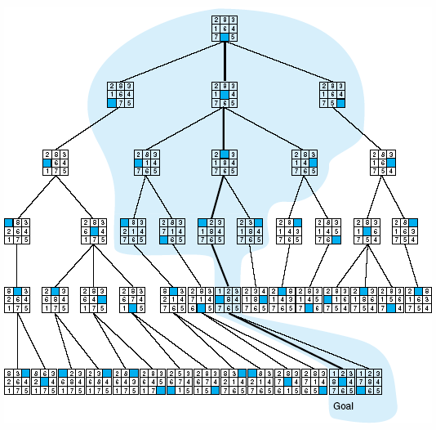
Fig 4.18 Comparison of state space searched using heuristic search with space searched by breadth-first search. The proportion of the graph searched heuristically is shaded. The optimal search selection is in bold. Heuristic used is f(n) = g(n) + h(n) where h(n) is tiles out of place.

Slide 62
More Informed Heuristics (2)
Trade-off of more informed heuristics
simple heuristic
requires less computation time
relies on the speed of the computer to search as deeply as possible into the search space
more informed heuristic
requires more computation time
may have exponential complexity
extremely important to optimize this trade-off between search and evaluation of heuristics

Slide 63
Using Heuristics in Games
The Minimax Procedure on Exhaustively Searchable Graphs
Minimaxing to Fixed Ply Depth
The Alpha-Beta Procedure

Slide 64
The Minimax Procedure on Exhaustively Searchable Graphs
Two-person games
more complicated than simple puzzle
because of the existence of a “hostile” and essentially unpredictable opponent
interesting as well as great difficulties in developing search algorithm
First we consider games whose state space is small enough to be exhaustively searched to find winning states

Slide 65
Example Game: Nim
Nim
a number of matches are placed on a table between the two opponents
at each move, the player must divide a pile of matches into two nonempty piles with different numbers of matches in each pile
6 matches may be divided into piles of 5 and 1 or 4 and 2, but not 3 and 3
the first player who can no longer make a move loses the game

Slide 66
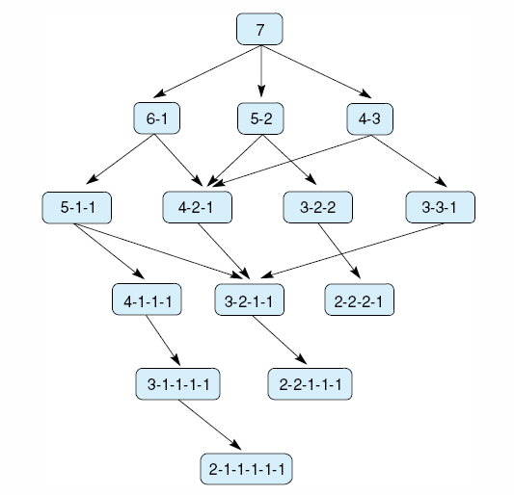
Fig 4.19 State space for a variant of nim. Each state partitions the seven matches into one or more piles.

Slide 67
MIN and MAX
MAX
represents the player trying
to win, or
to MAXimize her advantage
MIN
is the opponent who attempts to MINimize MAX’s score
Assumption
MIN uses the same information and
always attempts to move to a state that is worst for MAX

Slide 68
Implementation of MINIMAX
Label
each level in the search space is labeled according to whose move it is at that point in the game, MIN or MAX
each leaf node is given a value of 1 or 0
1: a win for MAX
0: a win for MIN
minimax propagates these values up the graph through successive parent nodes according to:
If the parent state is a MAX node, give it the maximum value among its children
If the parent is a MIN node, give it the minimum value of its children

Slide 69
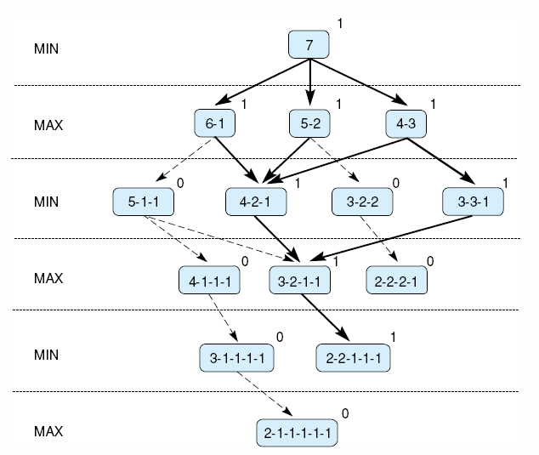
Fig 4.20 Exhaustive minimax for the game of nim. Bold lines indicate forced win for MAX. Each node is marked with its derived value (0 or 1) under minimax.
Who wins the game?

Slide 70
Minimaxing to Fixed Ply Depth
Most interesting case do not allow exhaustive search
in applying minimax to more complicated games
it is seldom possible to expand the state space graph out to the leaf nodes
the state space is searched to a predefined number of levels, as determined by available time and memory
n-move look-ahead
n is the number of levels explored
not possible to give values a win or a loss
instead, heuristic evaluation value is given

Slide 71
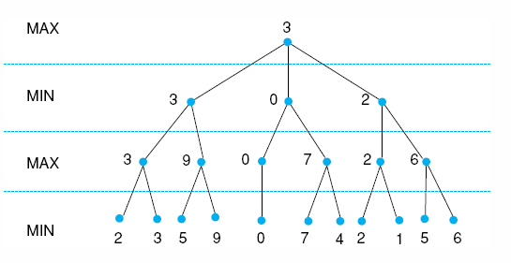
Minimaxing to Fixed Ply Depth (2)
Maximizing for MAX parents, and minimizing MIN parents, the values go back up the graph to the children of the current state
Fig 4.21 Minimax to a hypothetical state space. Leafstates show heuristic values; internal states show backed-up values.

Slide 72
MiniMax Procedure
Select the maximum worth alternative
Under assumption of that the opponent do her best
Back-Up Value (BUV)
1. At tip node p, BUV is e(p)
2. At MIN node, BUV is min of BUV of children
3. At MAX node, BUV is max of BUV of children
e(p): static evaluation function
if p is win for MAX, then e(p) = ∞
if p is win for MIN, then e(p) = −∞

Slide 73
MiniMax for Tic-Tac-Toe
Two player, X and O, X play first
Static evaluation function
if p is not a winning position
E(p) = (# of complete rows, columns, or diagonal that are still open for X) −
(# of complete rows, columns, or diagonal that are still open for O)
if p is a win for X, E(p) = ∞
if p is a win for O, E(p) = −∞
Zero-sum game !

Slide 74
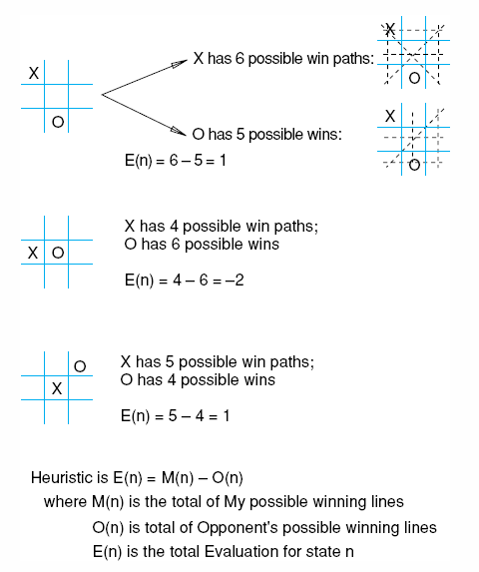
Fig 4.22 Heuristic measuring conflict applied to states of tic-tac-toe.

Slide 75
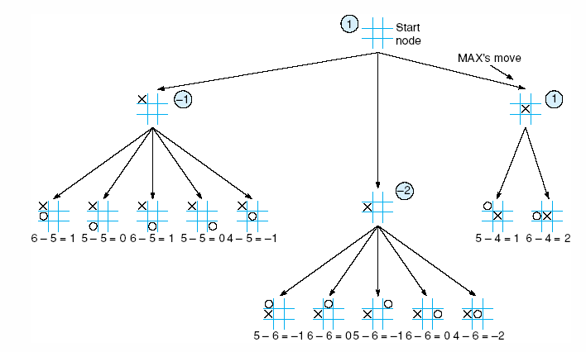
Fig 4.23 Two-ply minimax applied to the opening move of tic-tac-toe, from Nilsson (1971).

Slide 76
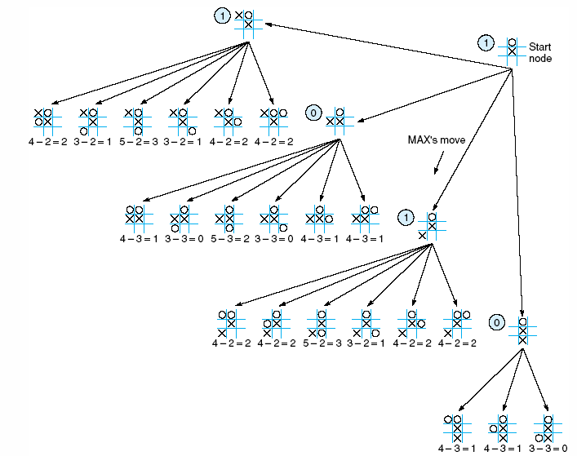
Fig 4.24 Two ply minimax, and one of two possible MAX second moves, from Nilsson (1971).

Slide 77
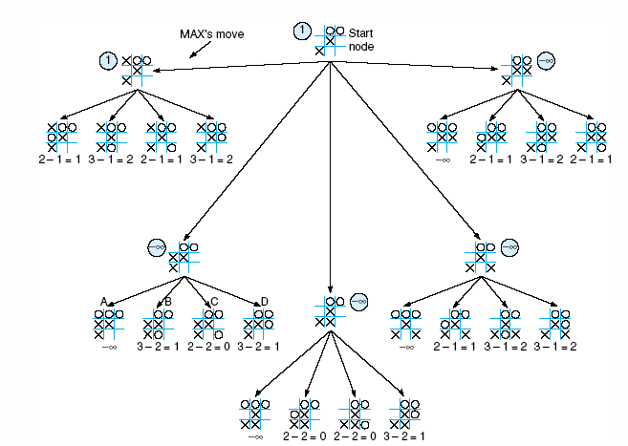
Fig 4.25 Two-ply minimax applied to X’s move near the end of the game, from Nilsson (1971).

Slide 78
Alpha-Beta Procedure
Straight MiniMax
require a two-pass analysis of the search space
the first to descend to the ply depth and there apply the heuristic and
the second to propagate values back up the tree
Improvement of MiniMax procedure
combining search procedure & evaluation
search proceeds in a depth-first fashion
two values, alpha and beta, are create during the search
alpha-value of MAX never decrease
beta-value of MIN never increase

Slide 79
Alpha-Beta Procedure (2)
Two rules for terminating search
1. Search can be stopped below any MIN node having a beta value less than or equal to the alpha value of any of its MAX ancestors.
2. Search can be stopped below any MAX node having an alpha value greater than or equal to the beta value of any of its MIN node ancestors.

Slide 80
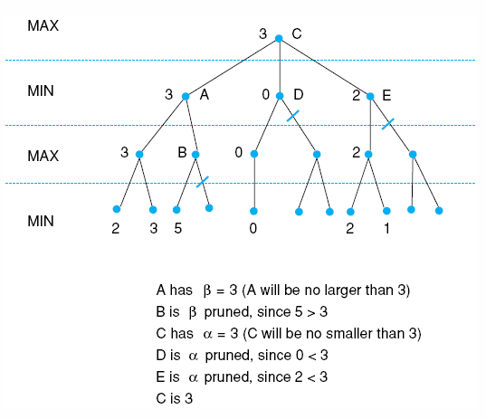
Fig 4.26 Alpha-beta pruning applied to state space of Fig 4.21. States without numbers are not evaluated.

Slide 81
Complexity Issues
Branching factor
defined as the average number of descendants that emerge from any state in the space
T = B + B² + B³ +…+B^{L} = B(B^{L} − 1) / (B − 1)
B: branching factor
L: path length
T: total states in the search
Size of open and closed lists
Informedness

Slide 82
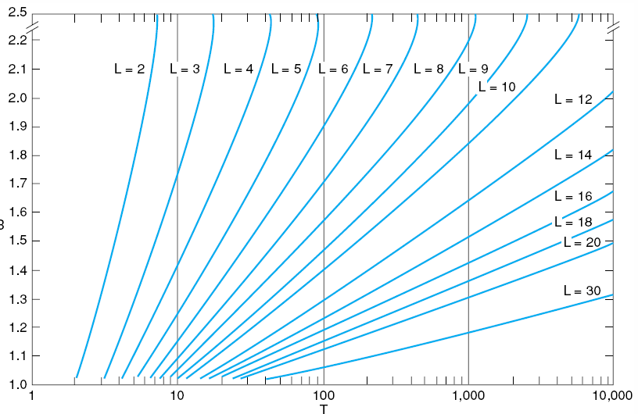
Fig 4.27 Number of nodes generated as a function of branching factor, B, for various lengths, L, of solution paths. The relating equation is T = B(B^{L} – 1)/(B – 1), adapted from Nilsson (1980).

Slide 83
Complexity Issues (2)
Size of open and closed lists
method of keeping the size of open reasonable : to save on open only a few of the best states
better focused search
danger of possibly eliminating the best, even the only solution path
beam search
technique of maintaining a size bound
Informedness
the more informed the search, the less the space must be searched
computational costs of additional information needed

Slide 84
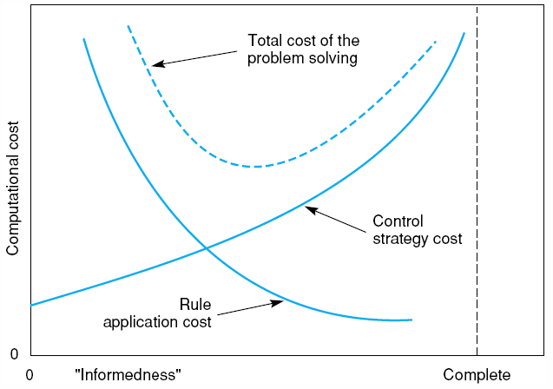
Fig 4.28 Informal plot of cost of searching and cost of computing heuristic evaluation against informedness of heuristic, adapted from Nilsson (1980).

